Slide 1
Medical Service Analysis In Bhutan
Presented By
Anima Uraon
Guided By
Miss Supriya Jadhav
Senior Data Scientist
Ex. Serviceman
Data Credit to : National statistics of bureau : https://www.nsb.gov.bt/

Slide 2
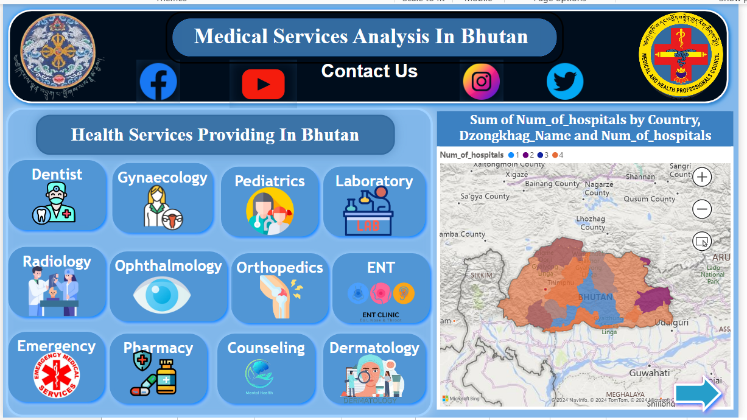
Data Credit to : National statistics of bureau : https://www.nsb.gov.bt/

Slide 3
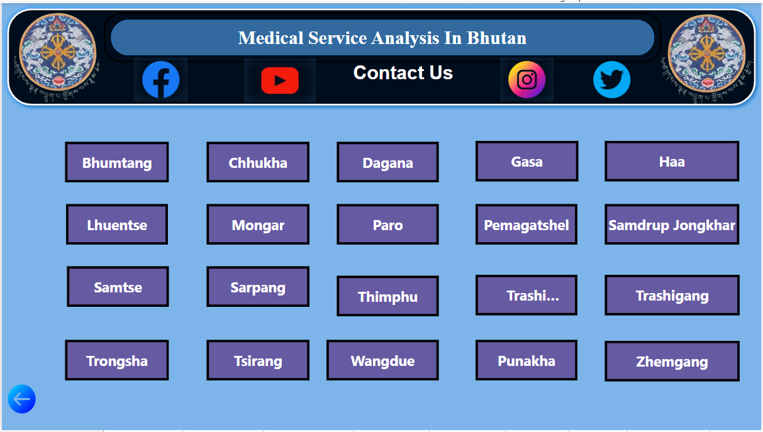
Data Credit to : National statistics of bureau : https://www.nsb.gov.bt/

Slide 4
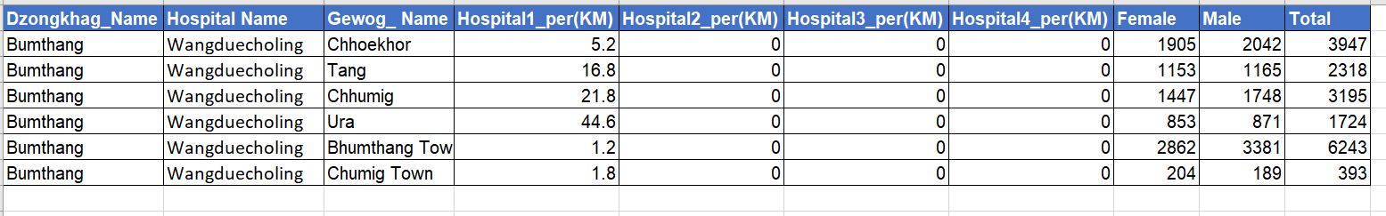
Data On Bumthang Dzongkhag With One Hospital
Data Credit to : National statistics of bureau : https://www.nsb.gov.bt/

Slide 5
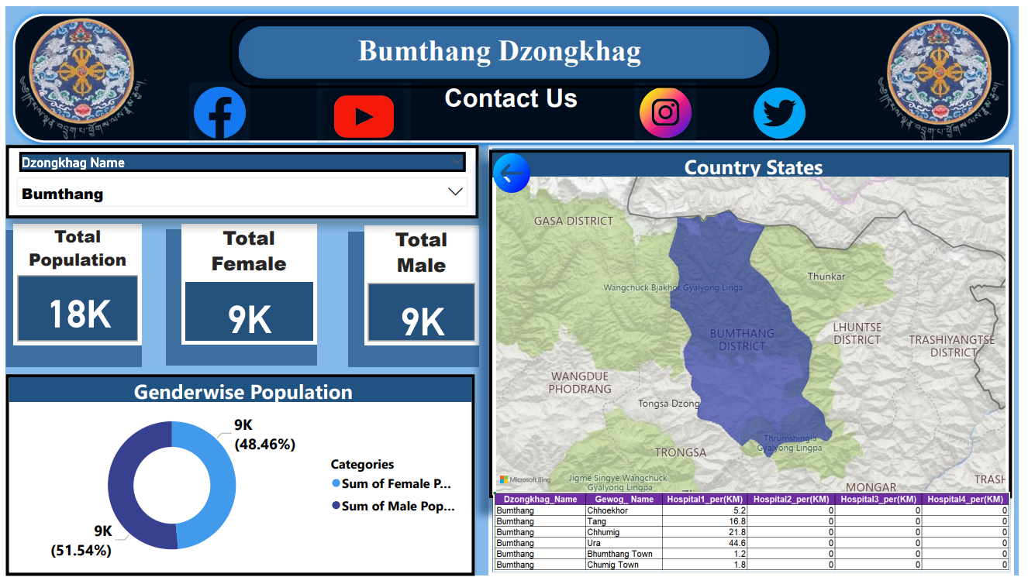

Slide 6
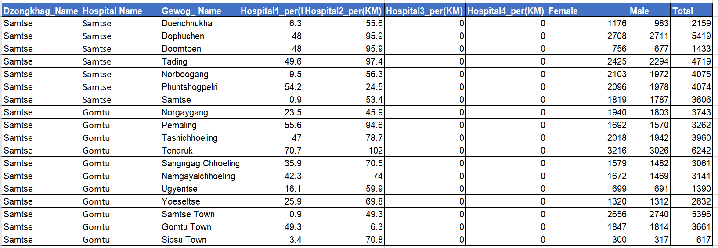
Data On Samtse Dzongkhag With Two Hospital
Data Credit to : National statistics of bureau : https://www.nsb.gov.bt/

Slide 7
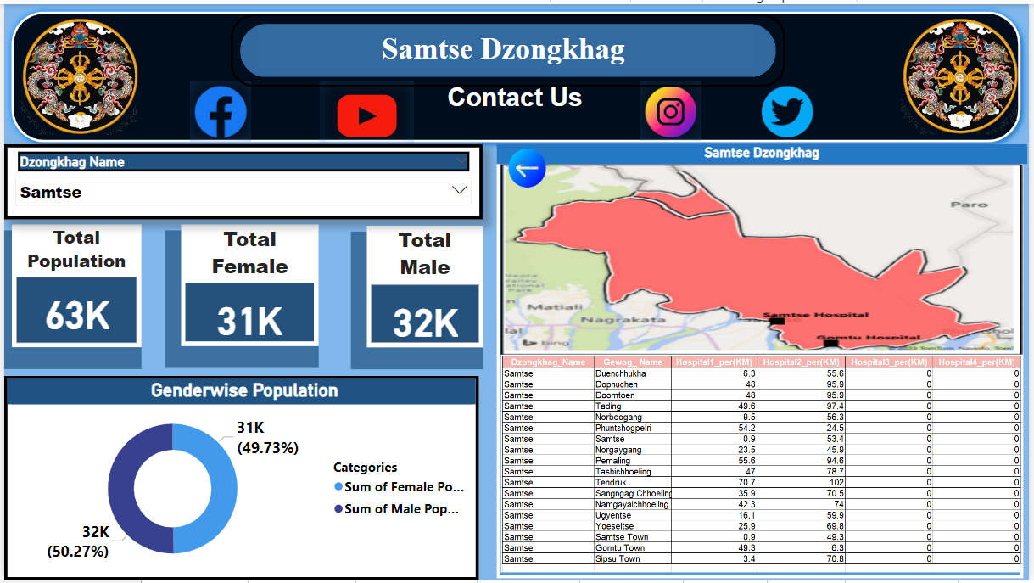

Slide 8
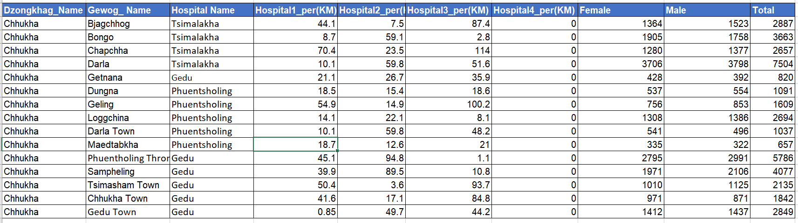
Data On Chukha Dzongkhag With Three Hospitals
Data Credit to : National statistics of bureau : https://www.nsb.gov.bt/

Slide 9
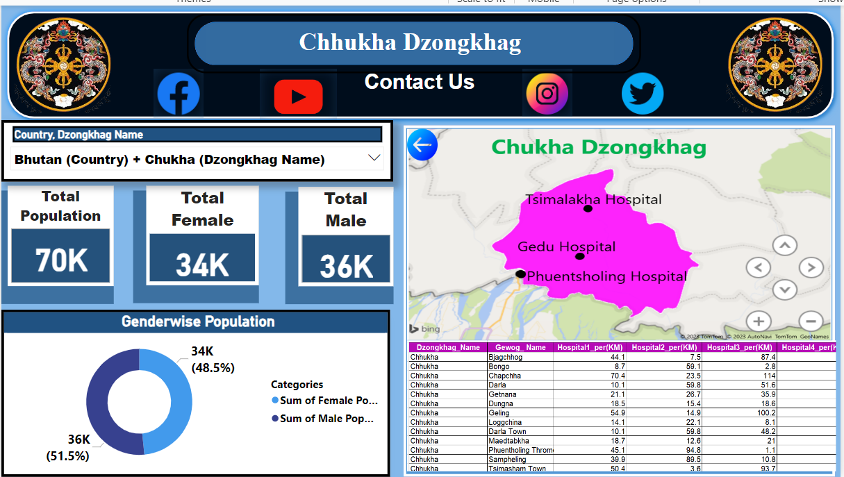

Slide 10
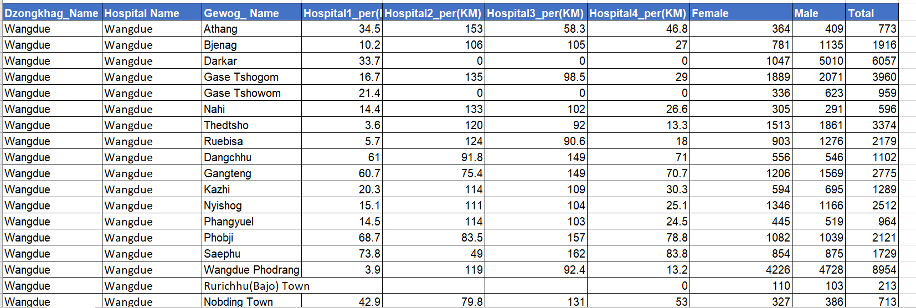
Data On Wangdue Dzongkhag With Four Hospitals
Data Credit to : National statistics of bureau : https://www.nsb.gov.bt/

Slide 11
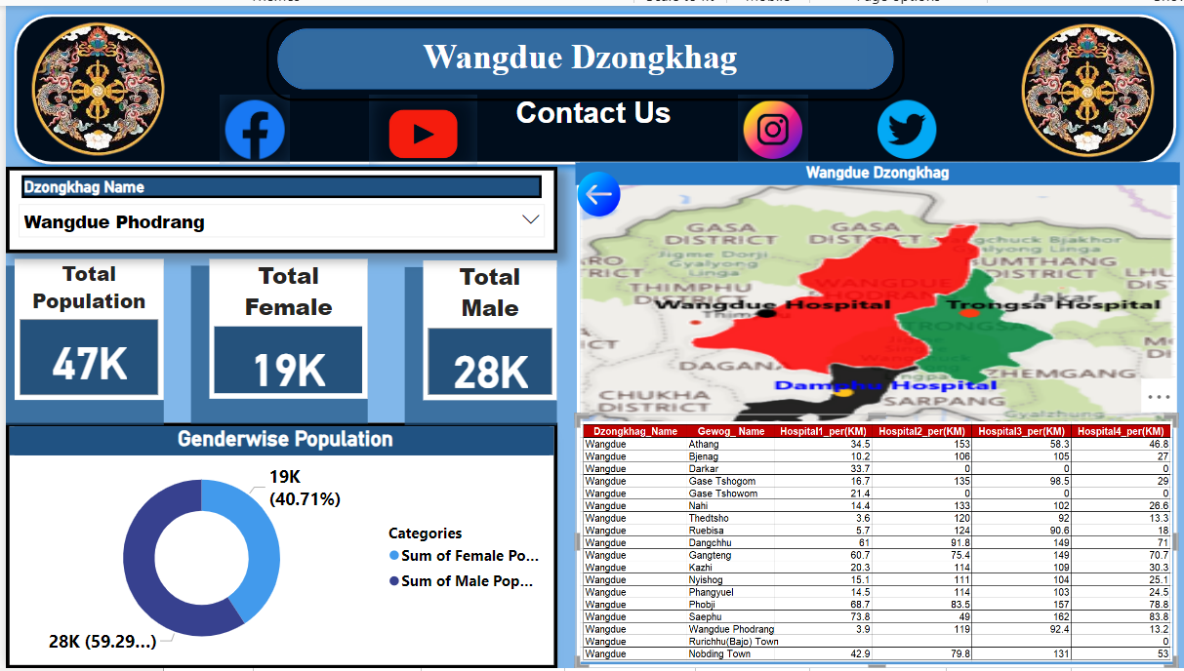
Data On Wangdue Dzongkhag With Four Hospital

Slide 12
Technologies Used
Mapping
Slicer
Card
Excel Tables
Buttons
Page Navigation
3D Effects
Pie Chart
Advance Editor

Slide 13
Thank You

